Slide 1
Lesson 10 – Reflection API, Annotations

Slide 2
Lesson goals
JVM and Memory
java.lang.reflect
java.lang.annotation

Slide 3
JVM Structure
*.class
CLASS LOADER
Runtime Data Area
Heap Memory
Non-heap Memory
Java Stack
Native method stack
GC
Execution Engine
Native Interface
Native Libs
*.dll

Slide 4
JVM Structure. Java Heap
Java Heap space is used by java runtime to allocate memory to Objects and JRE classes. Whenever we create any object, it’s always created in the Heap space.
Garbage Collection runs on the heap memory to free the memory used by objects that doesn’t have any reference. Any object created in the heap space has global access and can be referenced from anywhere of the application.

Slide 5
JVM Structure. Java Stack
Java Stack memory is used for execution of a thread. They contain method specific values that are short-lived and references to other objects in the heap that are getting referred from the method.
Stack memory is always referenced in LIFO (Last-In-First-Out) order. Whenever a method is invoked, a new block is created in the stack memory for the method to hold local primitive values and reference to other objects in the method.
As soon as method ends, the block becomes unused and become available for next method.
Stack memory size is very less compared to Heap memory.

Slide 6
JVM Structure. Java Heap/Stack
We can use -Xms and -Xmx JVM option to define the startup size and maximum size of heap memory. We can use -Xss to define the stack memory size.
When stack memory is full, Java runtime throws java.lang.StackOverFlowError whereas if heap memory is full, it throws java.lang.OutOfMemoryError: Java Heap Space error.

Slide 7
Errors Examples
More at:
https://www.geeksforgeeks.org/understanding-outofmemoryerror-exception-java/
https://www.baeldung.com/java-stack-overflow-error

Slide 8
ClassLoader
Class loaders are responsible for loading Java classes during runtime dynamically to the JVM
It is possible to implement your own Class loader
Almost all Java-based containers such servlet containers implement custom ClassLoaders to support features like hot deployment and runtime platform extensibility

Slide 9
ClassLoader
There are two types of built-in ClassLoader in Java:
Bootstrap Class Loader – It loads JDK internal classes, typically loads rt.jar and other core classes for example java.lang.* package classes
System Class Loader – It loads classes from the current classpath that can be set while invoking a program using –cp or –classpath command line options.

Slide 10
ClassLoader
public class ClassLoaderTest { public static void main(String[] args) { System.out.println("class loader for HashMap: " + java.util.HashMap.class.getClassLoader()); System.out.println("class loader for this class: " + ClassLoaderTest.class.getClassLoader()); System.out.println("class loader for external lib class: " + com.google.gson.Gson.class.getClassLoader()); } }

Slide 11
ClassLoader
class loader for HashMap:
null //native
class loader for this class:
jdk.internal.loader.ClassLoaders$AppClassLoader@77556fd
class loader for external lib class:
jdk.internal.loader.ClassLoaders$ExtClassLoader@68328ck

Slide 12
Native Methods
JNI (Java Native Interface) - standard mechanism for running code that is written in C / C ++ or Assembler languages, and is assembled as dynamic libraries
//native method declaration
public native int nativeMethod();
Java Application
JNI
DLL

Slide 13
Reflection API
The ability to examine or modify the runtime behavior of applications
read properties
update data
change model

Slide 14
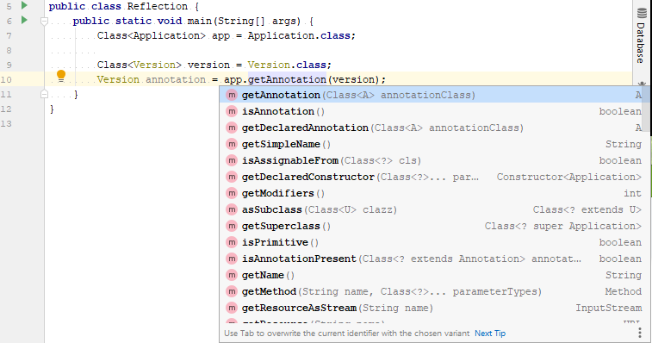
Reflection API

Slide 15
java.lang.Class
get the metadata of a class at run time
examine and change the run time behavior of a class

Slide 16
Class obtaining
forName() method of Class class
Class clazz = Class.forName(“org.geekhub.App");
getClass() method of Object class
Class clazz = instance.getClass();
the .class syntax
Class clazz = App.class
By classloader

Slide 17
Class instantiation
try {
Class<App> clazz = App.class;
App app = clazz.getConstructor().newInstance(); //requires no-args constructor log(app.getName()); } catch (InstantiationException | IllegalAccessException e) { log("Can not instantiate App by reflection: {}“, e.getMessage()); }

Slide 18
Class instantiation
try { Class[] argTypes = {
int.class, String.class, String.class
}; Constructor<App> constructor = clazz.getConstructor(argTypes); App app = constructor.newInstance(1, “App", "Some App desc"); log(app); //App{id=1, name=‘App’, description=‘Some App desc’} } catch (Exception e) { log("Error: {}", e.getMessage()); }

Slide 19
Declared fields
includes public, protected, default (package) access, and private fields, but excludes inherited fields
Class<App> clazz = App.class; Field[] declaredFields = clazz.getDeclaredFields(); for (Field field : declaredFields) { log("\t" + field); }

Slide 20
Fields
includes all the public fields up the entire class hierarchy
Class<App> clazz = App.class; Field[] fields = clazz.getFields(); for (Field field : fields) { log("\t" + field); }

Slide 21
Declared methods
includes public, protected, default (package) access, and private methods, but excluding inherited methods
Class<App> clazz = App.class; Method[] declaredMethods = clazz.getDeclaredMethods(); for (Method method : declaredMethods) { log("\t" + method); }

Slide 22
Methods
includes all the public methods up the entire class hierarchy
Class<App> clazz = App.class; Method[] methods = clazz.getMethods(); for (Method method : methods) { log("\t" + method); }

Slide 23
Invisible field update
Class<User> userClass = User.class; User user = new User(1, "John", 20, "UTF"); log(user.name); // John try { Field nameField = userClass.getDeclaredField("name"); nameField.setAccessible(true); nameField.set(user, "Roberto"); log(user.name); // Roberto } catch (NoSuchFieldException | IllegalAccessException e) { log("Error: {}“, e.getMessage()); }

Slide 24
Invisible method invocation
Class<User> userClass = User.class; User user = new User(1, "John", 20, "UTF");
log(user.name); // John try { Method setter = userClass.getDeclaredMethod("setName", String.class); nameSetter.setAccessible(true); nameSetter.invoke(user, "Roberto"); log(user.name); // Roberto } catch (NoSuchMethodException | IllegalAccessException | InvocationTargetException e) { log("Error: {}“, e.getMessage()); }

Slide 25
Annotations
@Deprecated
@Override
@SuppressWarnings
@FunctionalInterface
@NonNull
…

Slide 26
Annotations. RetentionPolicy
Retention Policy | Description
RetentionPolicy.RUNTIME | Signals to the Java compiler and JVM that the annotation should be available via reflection at runtime
RetentionPolicy.CLASS | Annotation is stored in the .class file, but not available at runtime. This is the default retention policy
RetentionPolicy.SOURCE | Annotation is only available in the source code, and not in the .class files and not a runtime. If you create your own annotations for use with build tools that scan the code, you can use this retention policy.

Slide 27
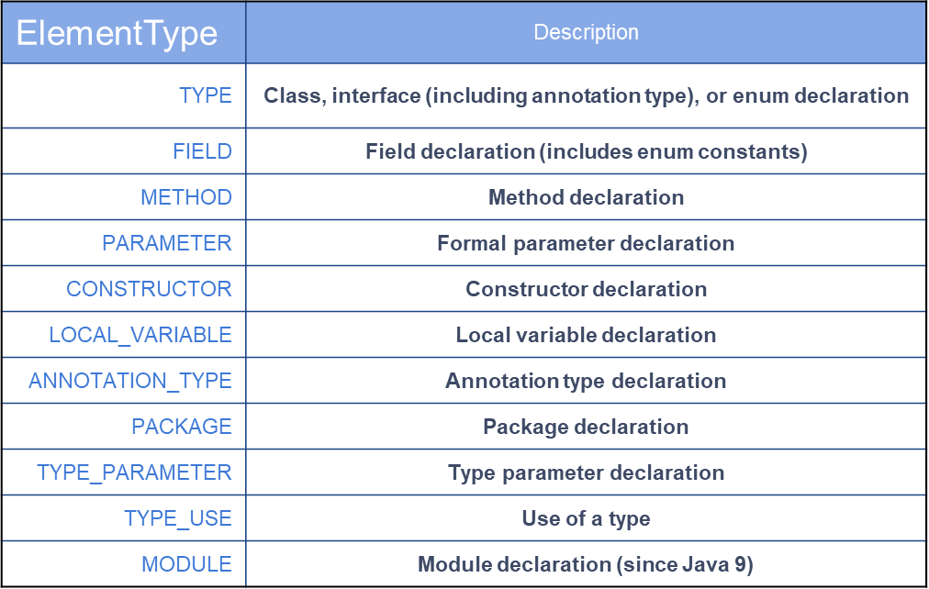
Annotations. ElementType

Slide 28
Annotations
@Target(value = ElementType.METHOD) @Retention(value = RetentionPolicy.RUNTIME) public @interface Version { int min(); int max(); String description() default ""; }

Slide 29
Annotations
class ApiClass { @Version // required attributes are missed void api0(){}
@Deprecated @Version(min = 1, max = 2) void api1(){}
@Version(min = 2, max = 3, description = “Some description") void api2(){} } @Version // wrong target element type class ApiClass2 {}

Slide 30
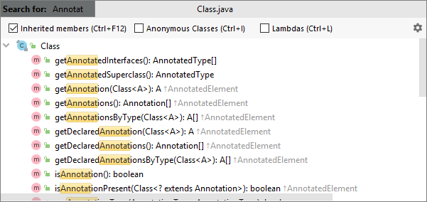
Class annotations usage

Slide 31
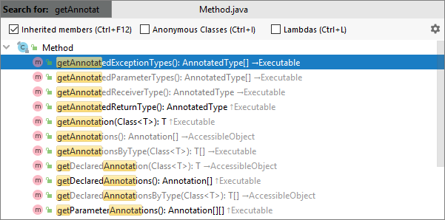
Method annotations usage

Slide 32
Homework. HackerRank
https://www.hackerrank.com/challenges/java-reflection-attributes/problem
https://www.hackerrank.com/challenges/java-annotations/problem

Slide 33
Homework. Students Registry
Add annotation @Dependency
Mark "dependency" classes with a @Dependency annotation
Find all Dependency classes*
Create an instance of StudentsRegistry class by injecting “dependency” objects using Java Reflection API

Slide 34
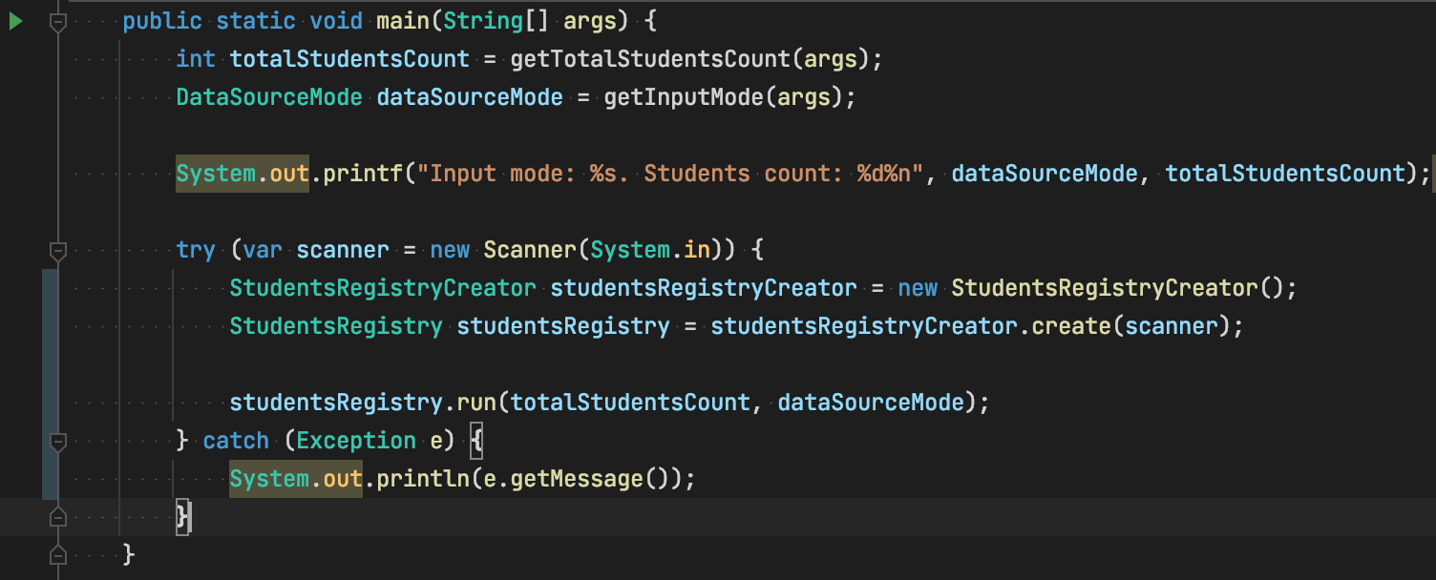
Homework. Contract

Slide 35
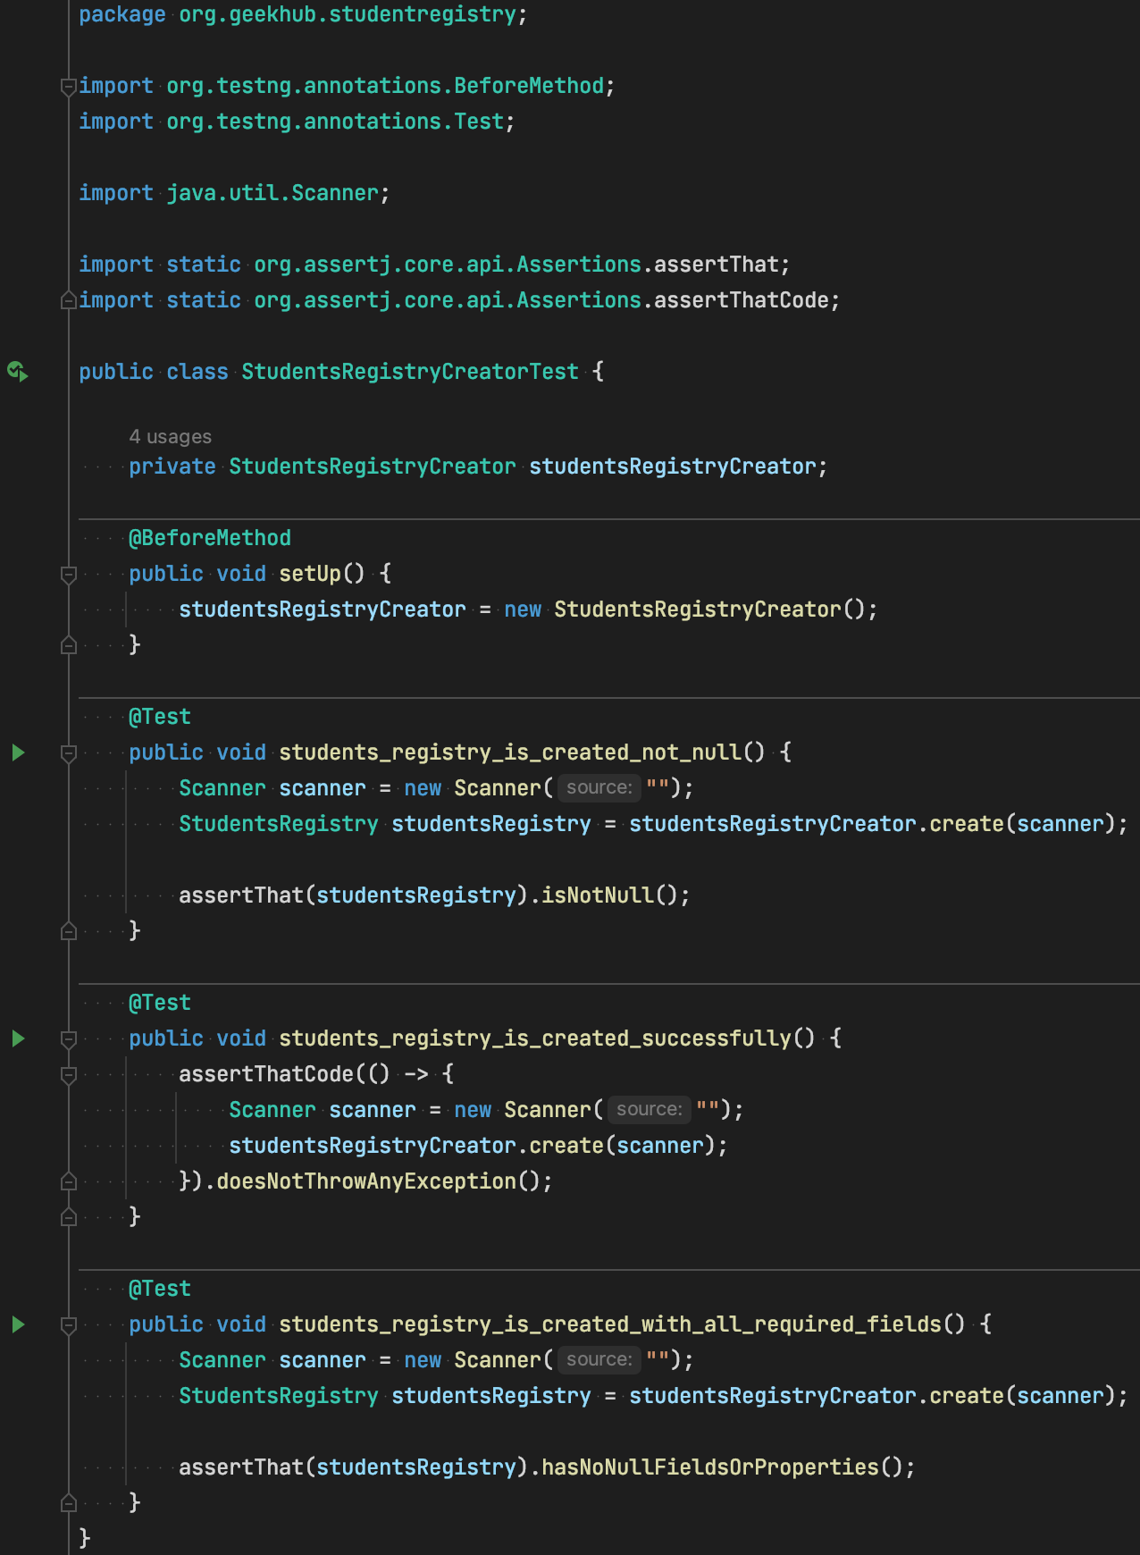
Homework. Unit Tests

Slide 36
Links
Reflection API
Using java reflection
Annotations
Memory model
Java classloaders

Slide 37
Thanks!
Any Questions?
Or find us in Slack:
@Yaroslav Brahinets
@Vasya Rudas

